Slide 1

WORKOUT APP
COMP 437 TERM PROJECT BY ÖZLEM ŞERİFOĞULLARI

Slide 2
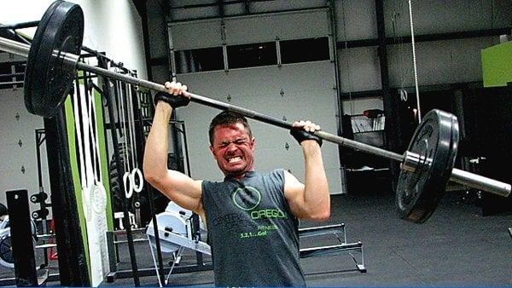

Slide 3
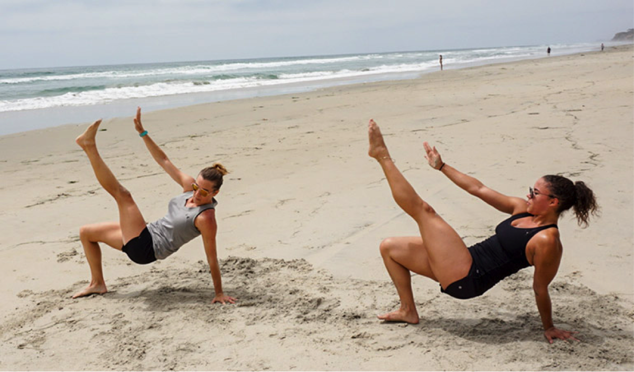
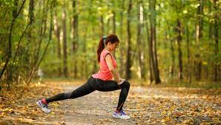
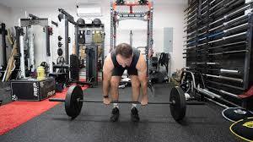

Slide 4
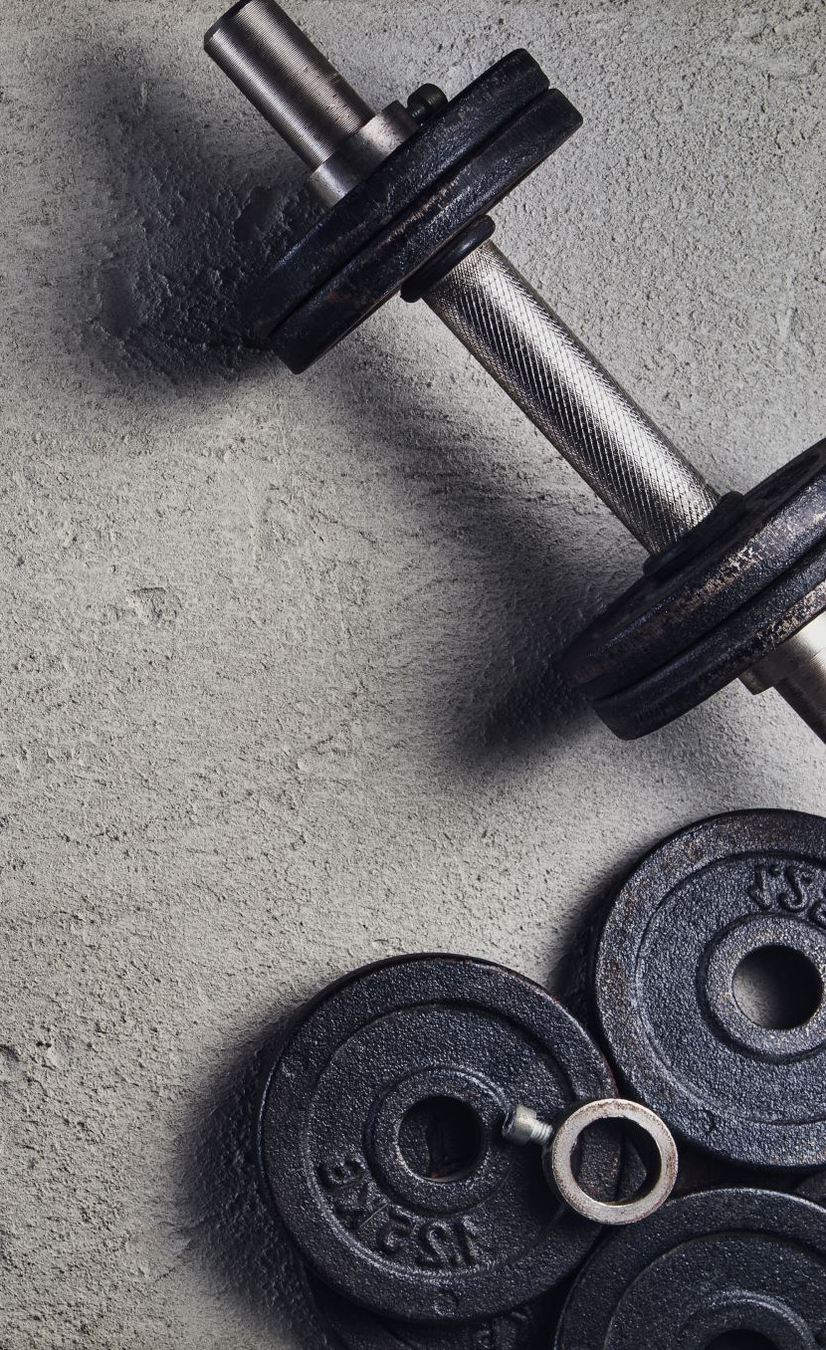
Workout app can be a need
Physical activity is important for healthy life [1], [2]
Money, time, and irregular lifestyle are barriers to workout regularly [3]
People prefer individualized workout programs [4]
Even if people overcome finacial matter and become a member of a gym, gym attendence is very low. Gym members overestimate their workout attandence by %39 margin [5]
[1] International Journal of Physical Education, Sports and Health 2016; 3(5): 22-27
[2] Janssen, I., LeBlanc, A.G. Systematic review of the health benefits of physical activity and fitness in school-aged children and youth. Int J Behav Nutr Phys Act 7, 40 (2010). https://doi.org/10.1186/1479-5868-7-40
[3] X. Chen, Z. Zhu, M. Chen and Y. Li, "Large-Scale Mobile Fitness App Usage Analysis for Smart Health," in IEEE Communications Magazine, vol. 56, no. 4, pp. 46-52, April 2018, doi: 10.1109/MCOM.2018.1700807
[4] Cadmus-Bertram LA, Gorzelitz JS, Dorn DC, Malecki KMC. Understanding the physical activity needs and interests of inactive and active rural women: a cross-sectional study of barriers, opportunities, and intervention preferences. J Behav Med. 2020 Aug;43(4):638-647. doi: 10.1007/s10865-019-00070-z. Epub 2019 Jun 13. PMID: 31197537; PMCID: PMC7891881
[5] https://doi.org/10.1016/j.psychsport.2020.101758

Slide 5
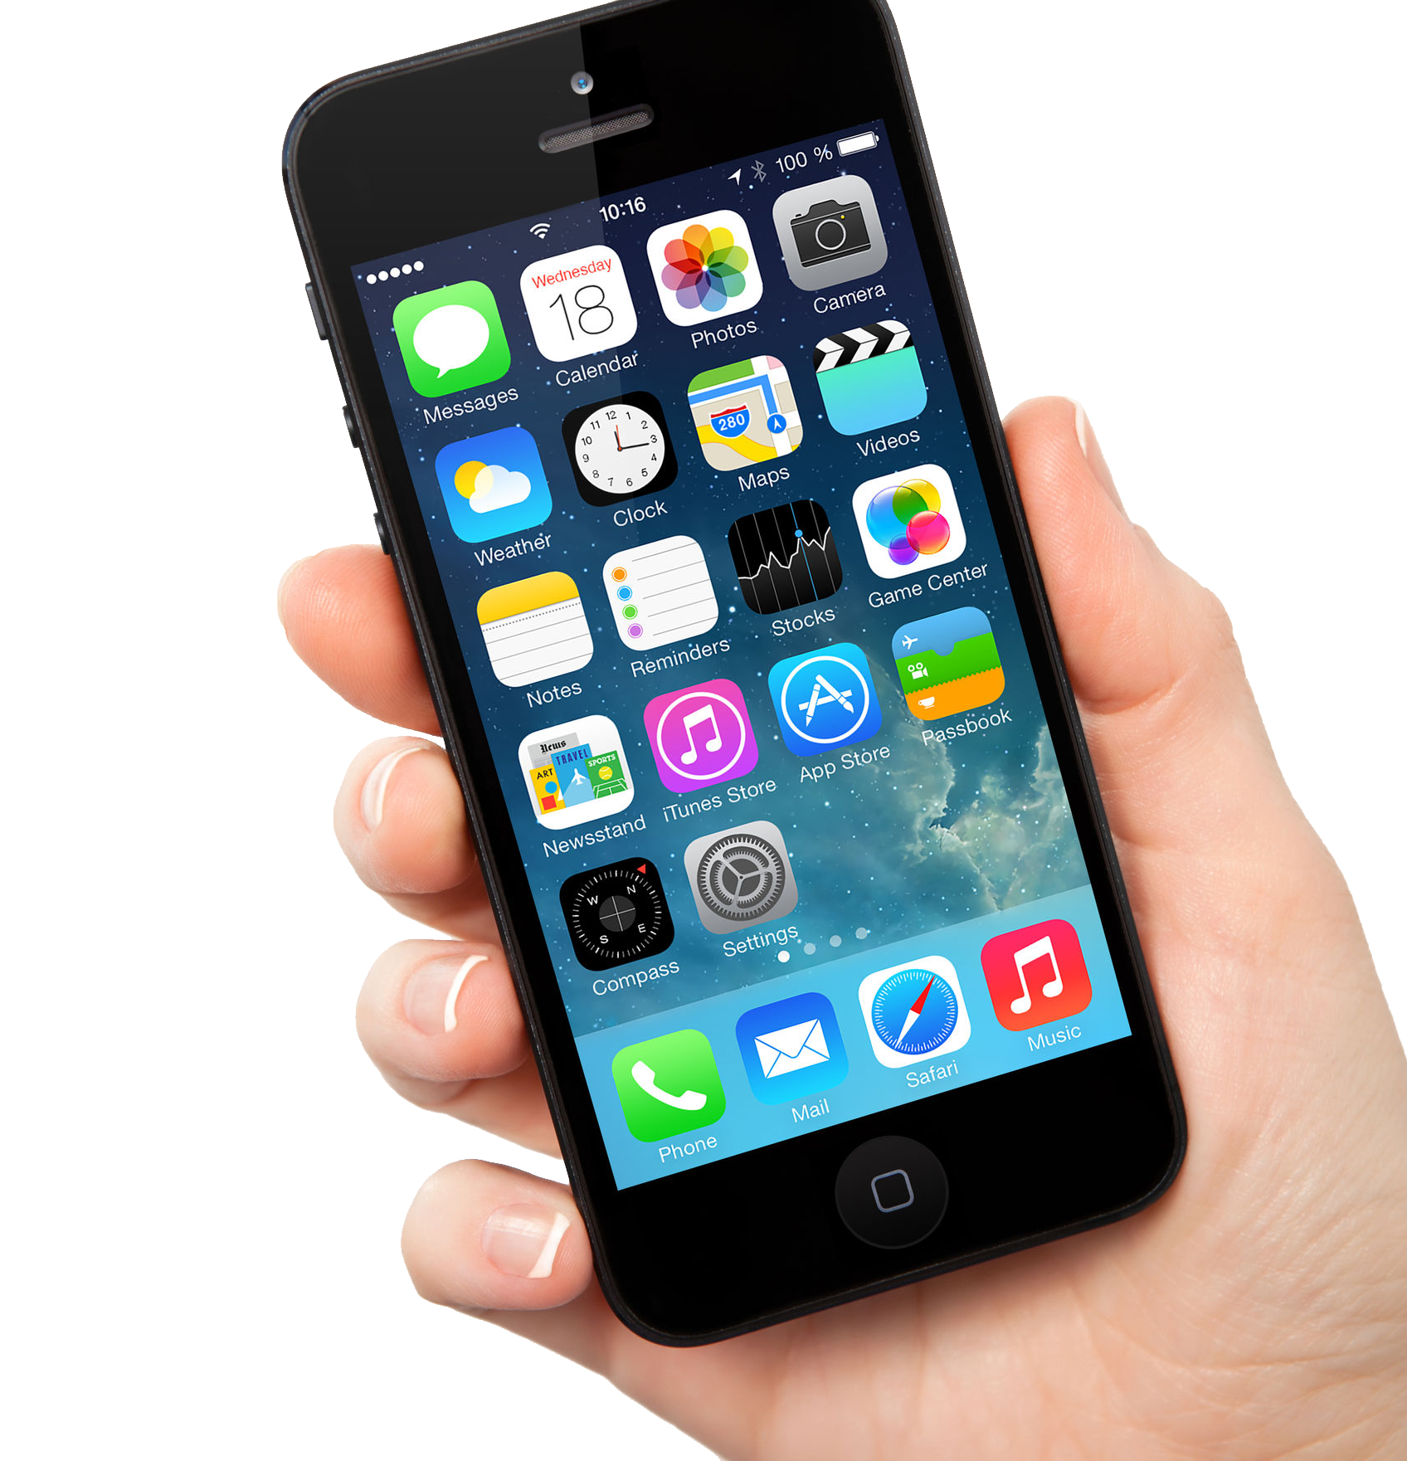
Workout app can be better
During Covid-19 lockdown in China, people prefered to use mobile apps to maintanin physical activity [7]
Gamified AR applications have great potential for enhancing user enjoyment [8]
Using AR technology can result better learning outcomes, for example mirror metaphor[9]
[7] Liu R, Menhas R, Dai J, Saqib ZA, Peng X. Fitness Apps, Live Streaming Workout Classes, and Virtual Reality Fitness for Physical Activity During the COVID-19 Lockdown: An Empirical Study. Front Public Health. 2022 Jun 22;10:852311. doi: 10.3389/fpubh.2022.852311. PMID: 35812515; PMCID: PMC9257108
[8] M. Noreikis, N. Savela, M. Kaakinen, Y. Xiao and A. Oksanen, "Effects of Gamified Augmented Reality in Public Spaces," in IEEE Access, vol. 7, pp. 148108-148118, 2019, doi: 10.1109/ACCESS.2019.2945819
[9] M. E. C. Santos, A. Chen, T. Taketomi, G. Yamamoto, J. Miyazaki and H. Kato, "Augmented Reality Learning Experiences: Survey of Prototype Design and Evaluation," in IEEE Transactions on Learning Technologies, vol. 7, no. 1, pp. 38-56, Jan.-March 2014, doi: 10.1109/TLT.2013.37
This Photo by Unknown Author is licensed under CC BY-NC

Slide 7
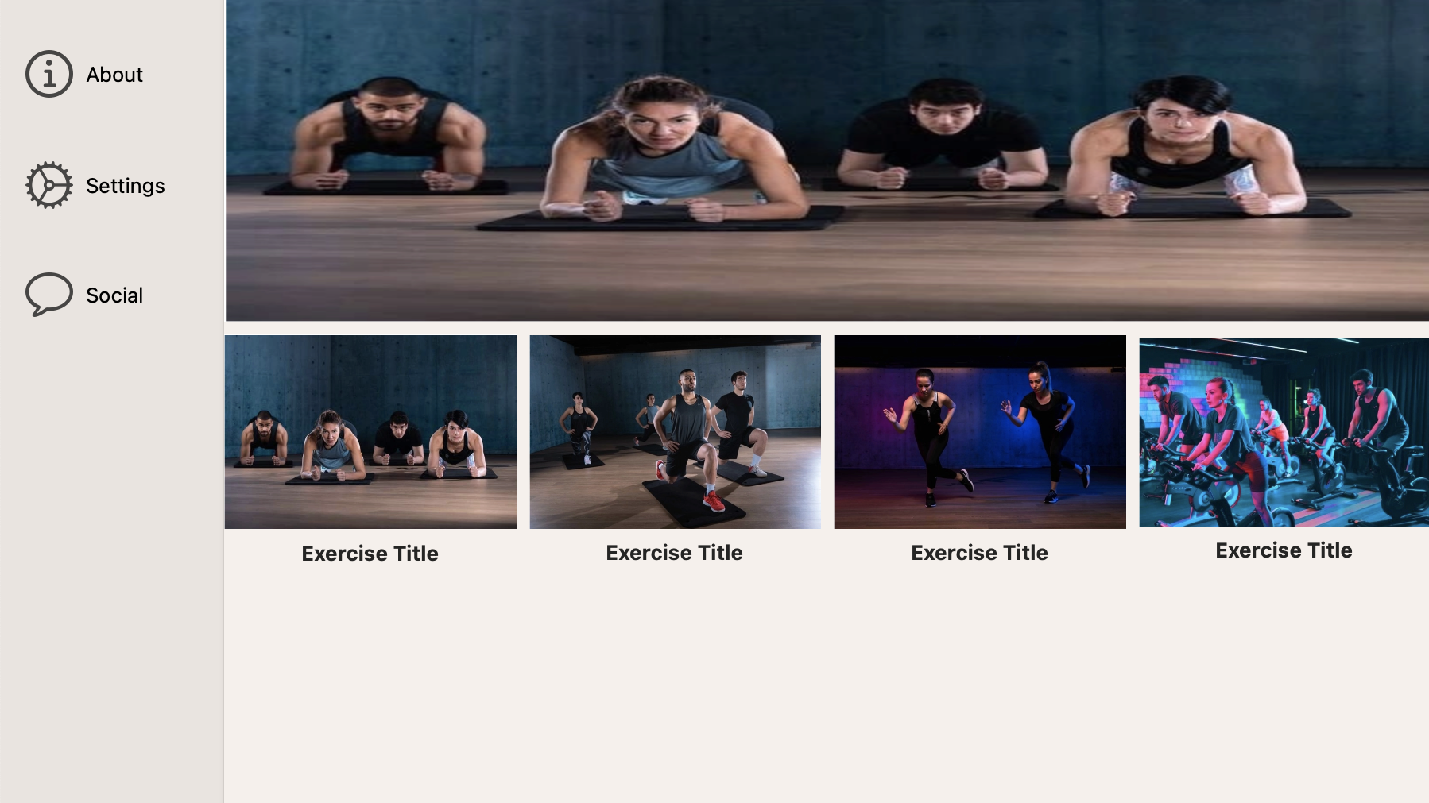
MacOS App
Writing a swift application

Slide 8

Changing Backgorund in Real-Time
Conduct a research
https://towardsdatascience.com/change-the-background-of-any-image-with-5-lines-of-code-23a0ef10ce9a
https://www.analyticsvidhya.com/blog/2021/07/learn-how-to-do-real-time-background-replacement-using-opencv-and-cvzone/
https://faun.pub/real-time-background-changing-in-python-a34511418077
https://www.banuba.com/blog/how-to-add-video-background-changer-to-your-app
OpenCV and Python
How to embed pyhton code into swift application
https://betterprogramming.pub/from-swift-import-python-f2fc2a997d4
https://medium.com/swift2go/embedding-python-interpreter-inside-a-macos-app-and-publish-to-app-store-successfully-309be9fb96a5

Slide 9

Tensorflow
Use body movements to navigate in application
Swift for Tensorflow
https://www.tensorflow.org/swift/guide/overview

Slide 10

Body detection and creating skeleton
Conduct research
https://blog.xmartlabs.com/blog/computer-vision-techniques-for-body-detection/
Tensorflow pose estimation
https://www.tensorflow.org/lite/examples/pose_estimation/overview

Slide 11
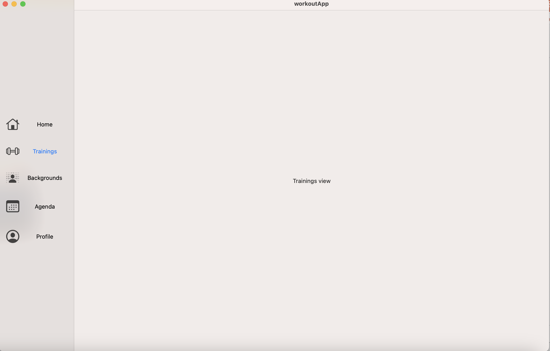
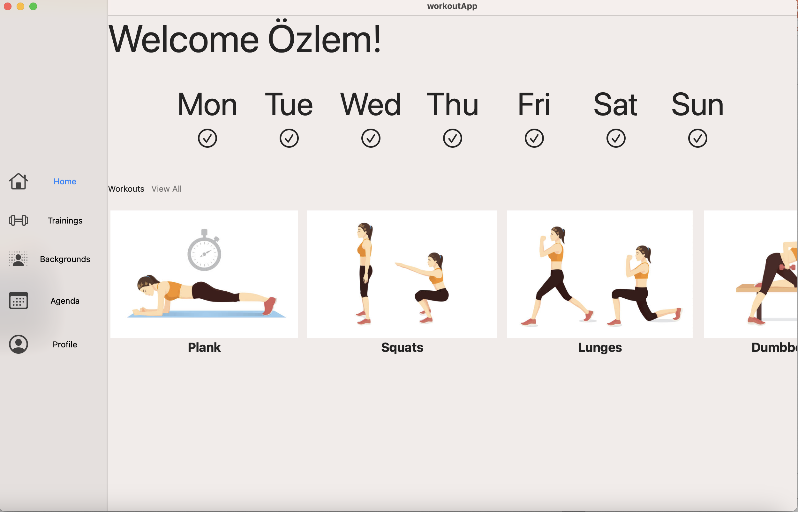
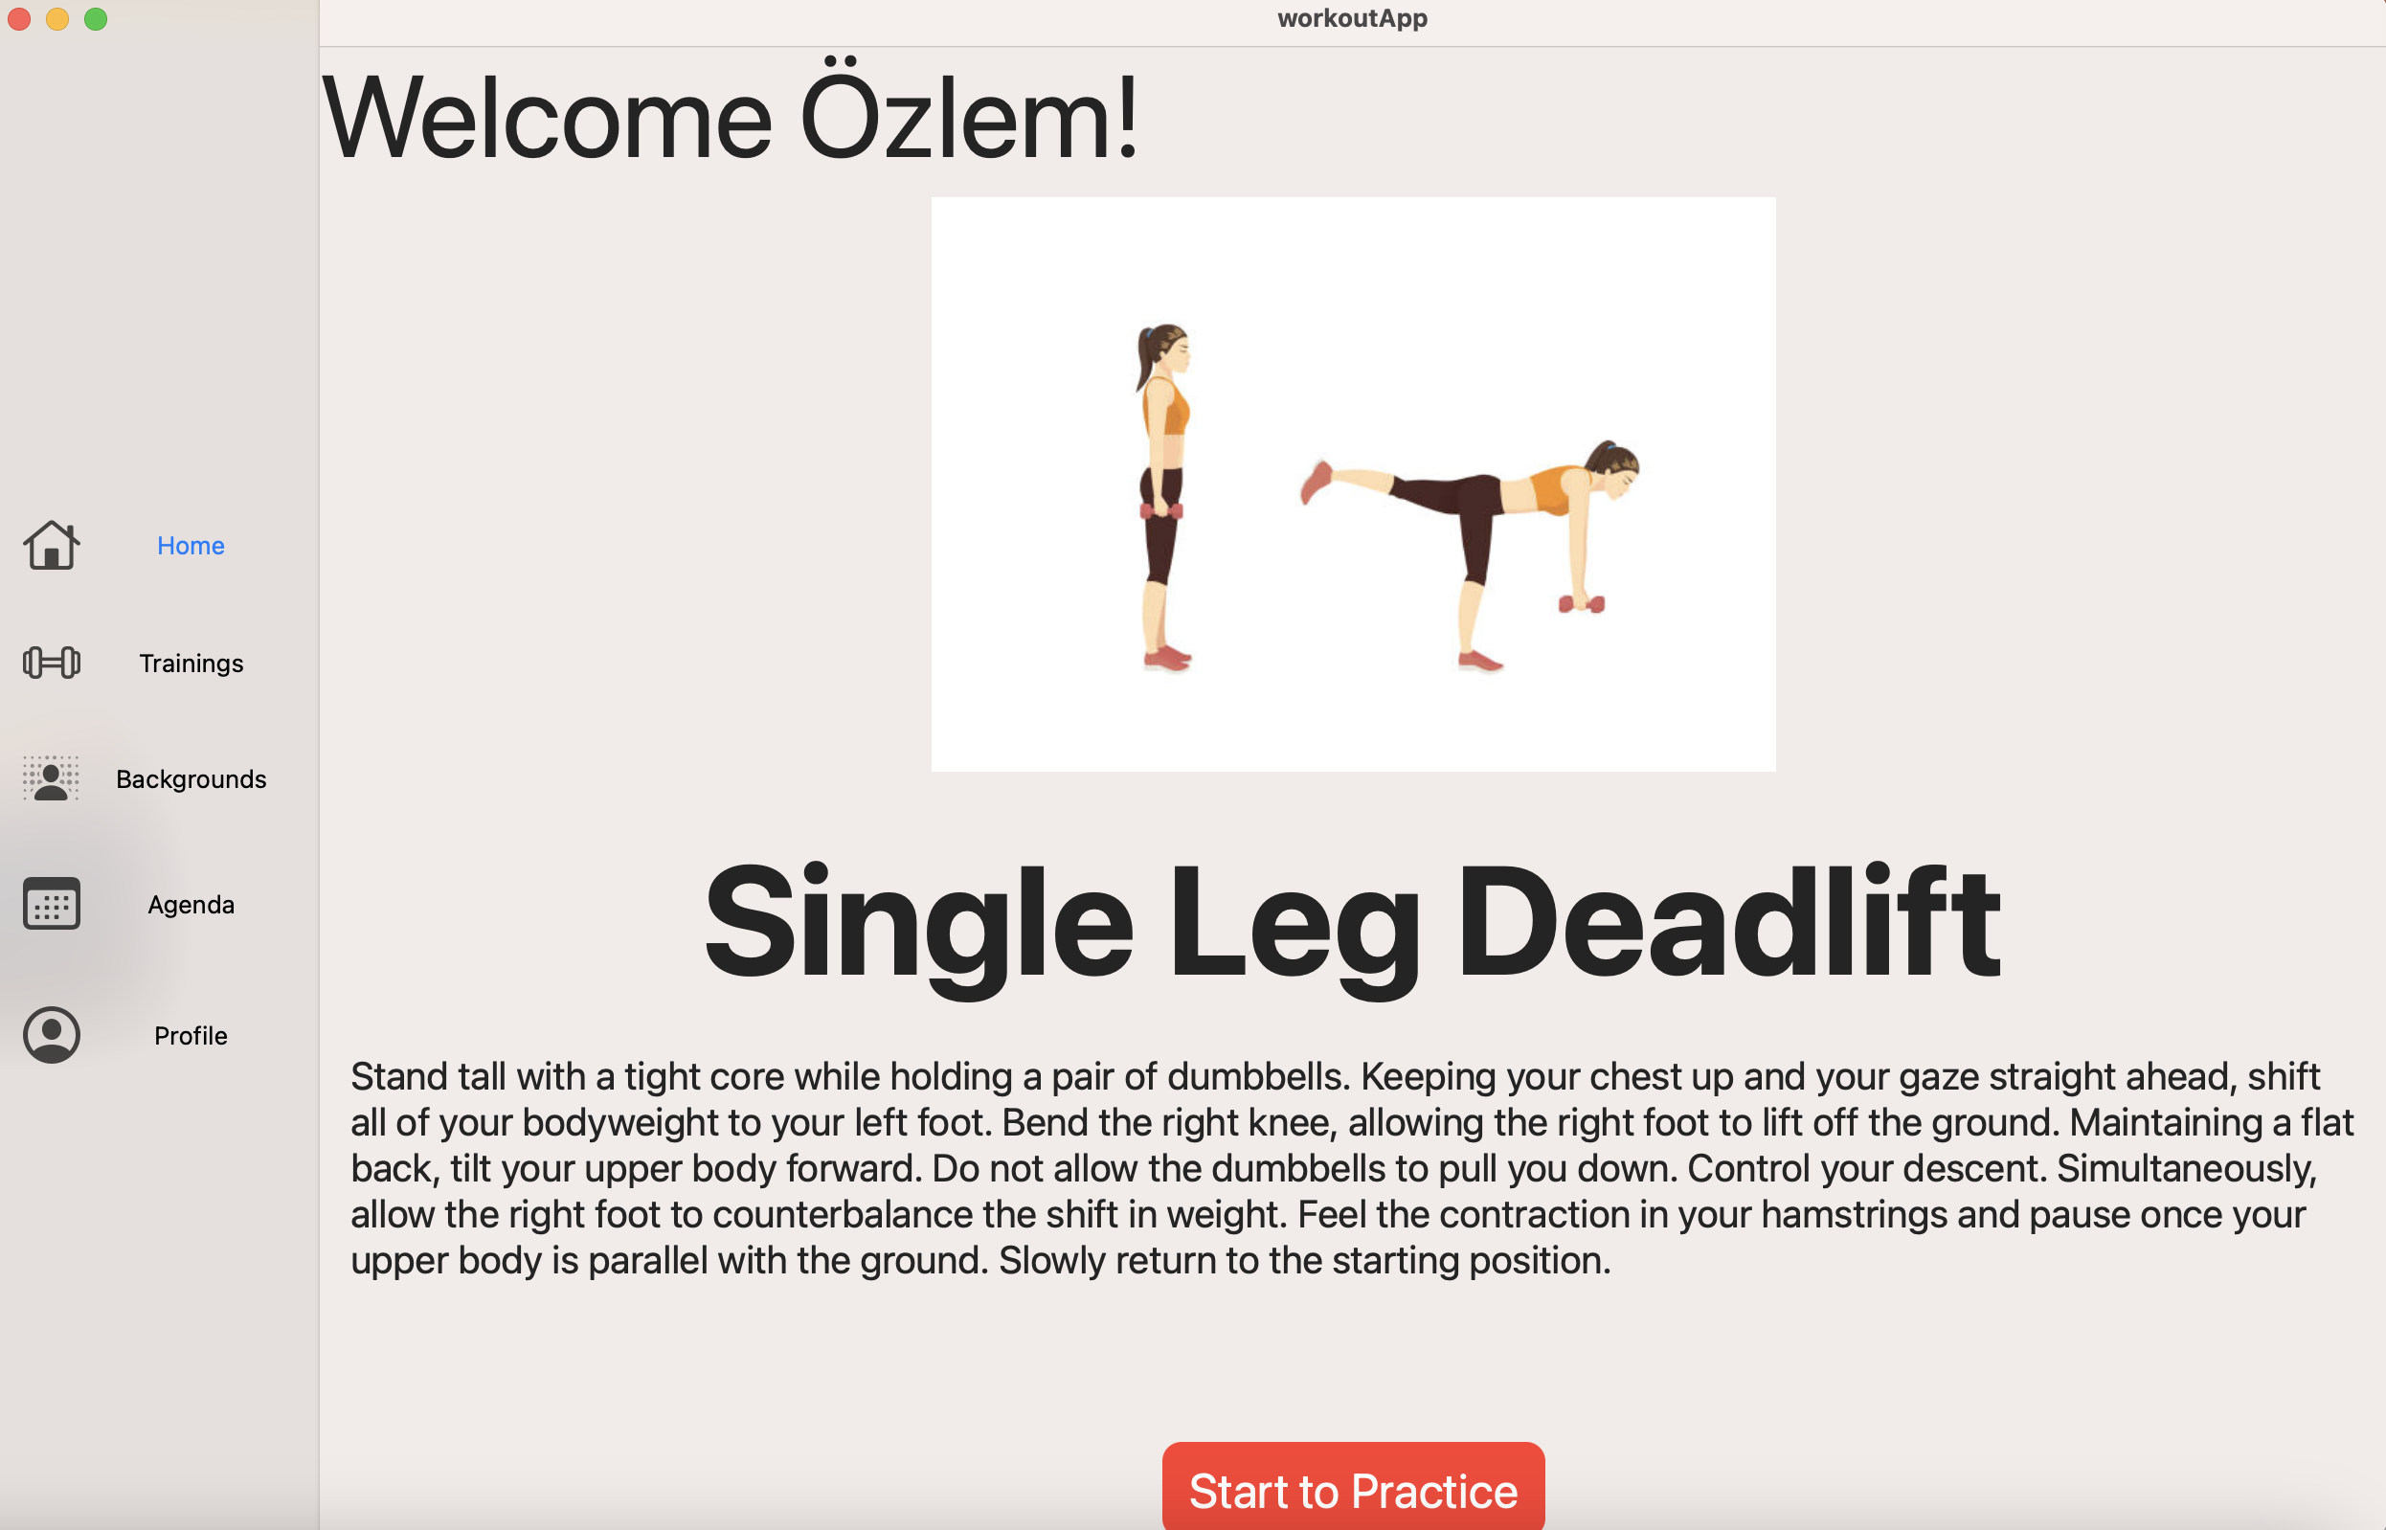
Workout App

Slide 12
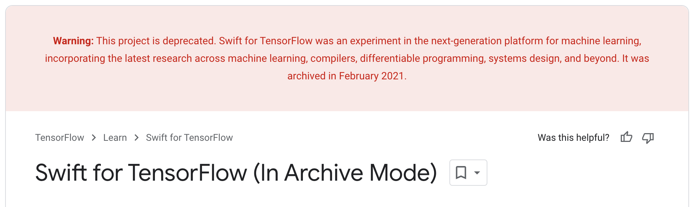
Background Changing and Pose Estimation
CVZone
OpenCV

Slide 13
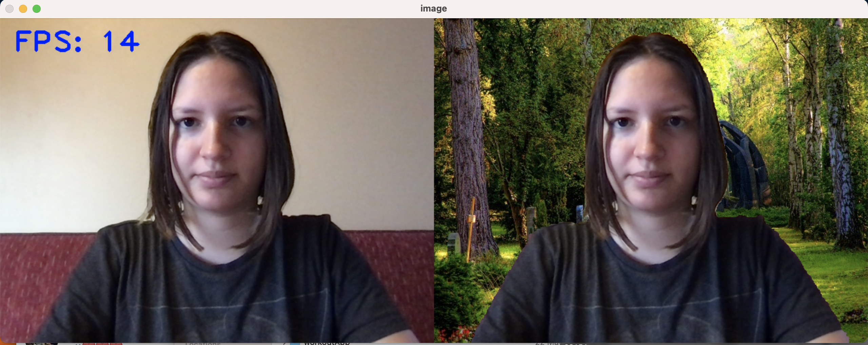
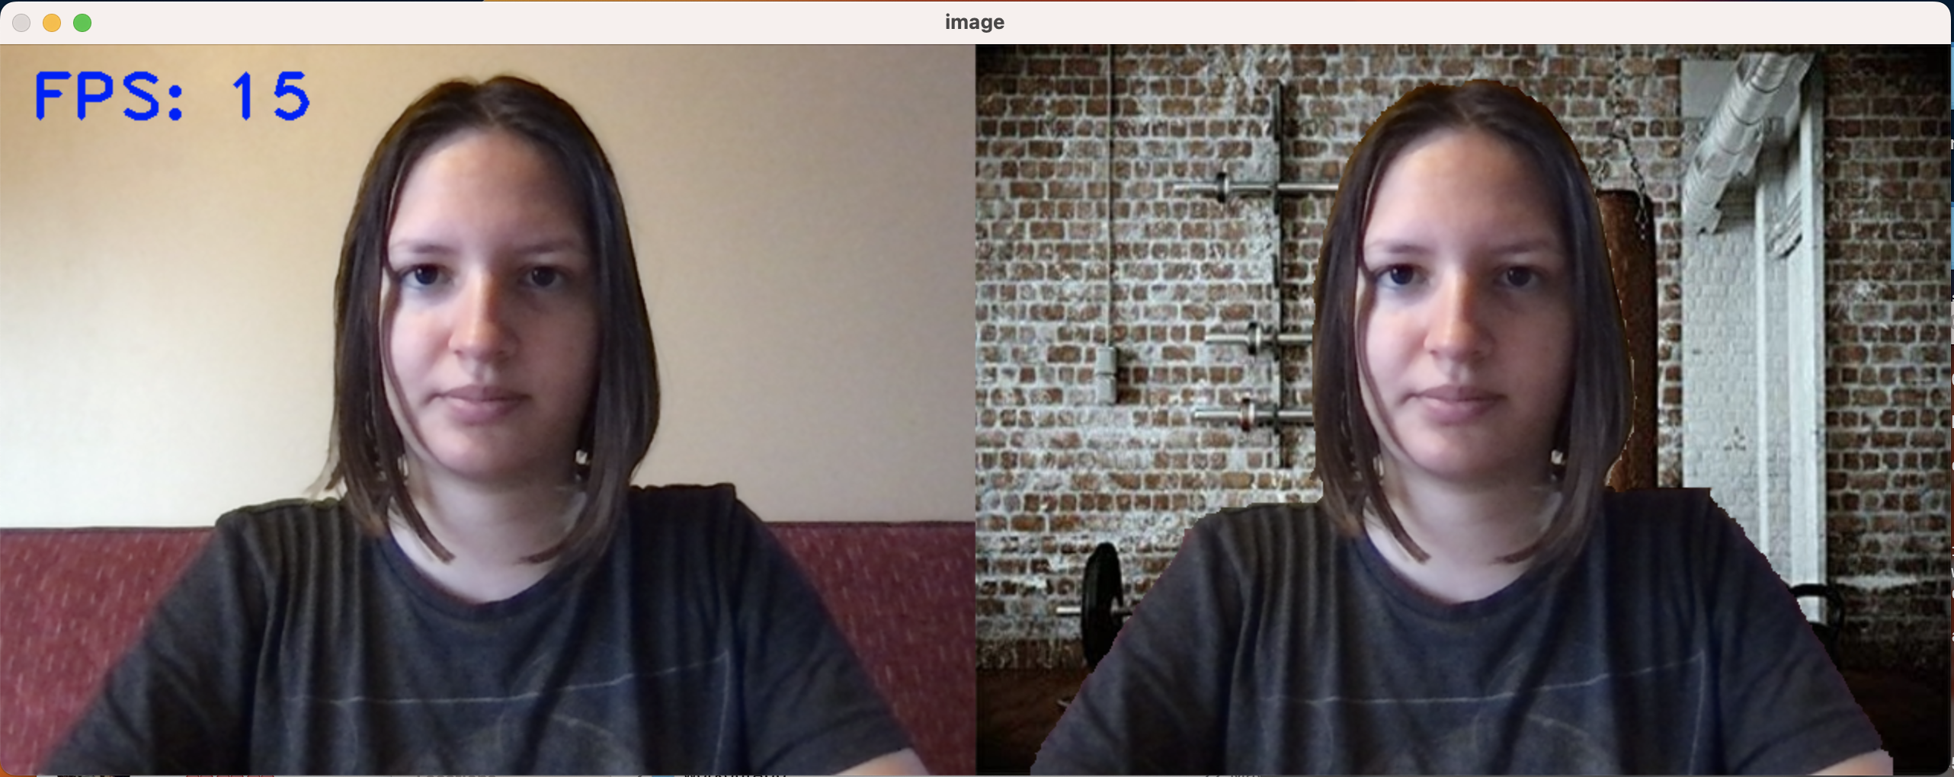

Slide 14
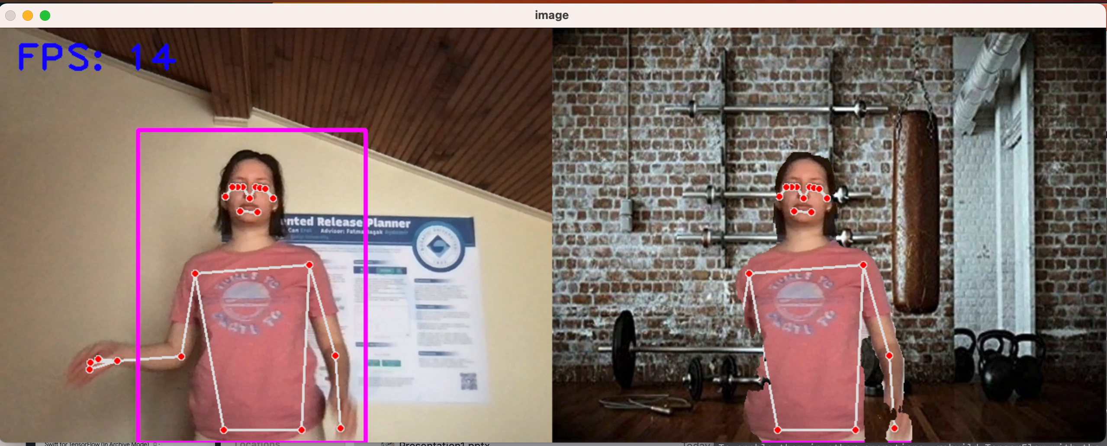
Result

Slide 15
Challenges
Swift MacOS App
Embed Python Code in SwiftUI
Using pose estimation and changing background together

Slide 16

Questions?

Slide 17

Thank you for listening

